Slide 1


Functional programming in concurrent and distributed systems
381-1-0112 | SM B 2021 | Tutorial 8
David Leon

Slide 2
Distributed Programming - Outline
Links and Monitors
Motivation
Links
Example
Monitors
Example
Distributed Erlang Programming
Local Nodes
“net_kernel” Module
Node name
Cookies
Simple Name Server
Homework I and II – Establishing communication between local and non-local nodes.
RPC
Example
More about RPC
Submission Procedures
Assignment 8

Slide 3
#1 Motivation
Examined system: Logger
A process that receives messages upon occurrence of specified events
Process “logger”
For some of the received messages, another process is notified to show a message on screen
Process “printer”
Process “printer” is spawned by “logger” when it starts
Upon an occurrence of an error in “logger”, a new process is created to handle the log messages
What problem may occur in system?
Multiple “printer” processes may be created and left unused

Slide 4

#2 Links
There may be a dependency between running processes
An error in a process may trigger a series of errors in other processes
Letting them die and restarting the whole group may be an acceptable alternative
What is a link?
A bidirectional relationship that can be created between two processes
If one of the linked processes dies from an unexpected throw, error or exit, the other linked process also dies
How to set or remove a link?
Using BIFs link/1 or spawn_link/1-3 and unlink/1
Both functions receive the linked PID as an argument

Slide 5
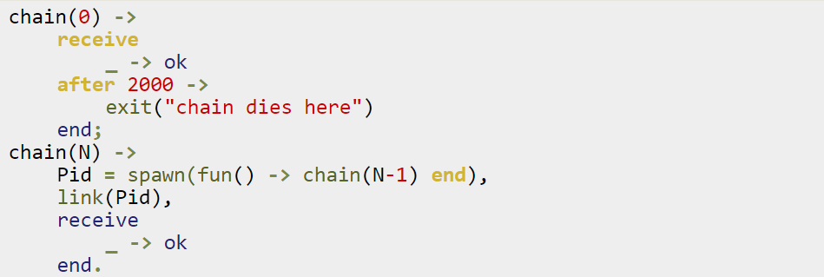
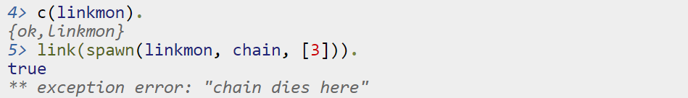
#2.1 Links: Example
Calling and linking chain/1 in the shell:

Slide 6
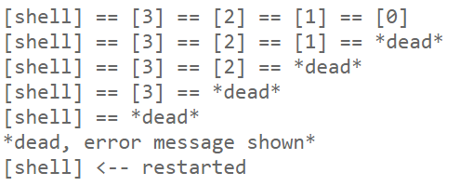
#2.1 Links: Example

Slide 7
#3 Monitors
What if processes does not have to die when another process dies?
When a process only wants to know what's going on with a second process
When neither of the processes really are vital to each other
What is a monitor?
A unidirectional relationship between two processes
If a monitored process goes down, the monitoring process is notified by a message
Can be used also to monitor changes in time offset between Erlang machines
How to set or remove a monitor?
Using BIFs monitor/2 or spawn_monitor/1,3 and demonitor/1,2

Slide 8
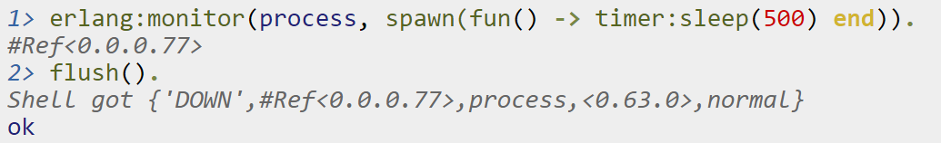
#3.1 Monitors: Example
Example of using monitor/2
Tag
‘DOWN’
‘CHANGE’
MonitorRef
Monitoring relationship identifier
Type
process →
time_offset →
Port →
Object
PID →
RegisteredName
{RegisteredName, Node}
clock_service →
Port →
RegisteredName
{RegisteredName, Node}
Info
no proc
NewTimeOffset
noconnection

Slide 9
Monitor
When a process terminates, it always terminates with an exit reason. The reason can be any term.
A process is said to terminate normally, if the exit reason is the atom normal. A process with no more code to execute terminates normally.
A process terminates with an exit reason {Reason,Stack} when a run-time error occurs.

Slide 10
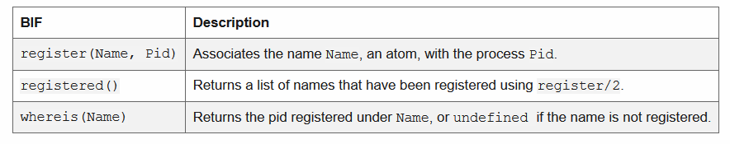
Register
Besides addressing a process by using its pid, there are also BIFs for registering a process under a name. The name must be an atom and is automatically unregistered if the process terminates:
The name of registered PID “lives” within the PID’s node.

Slide 11

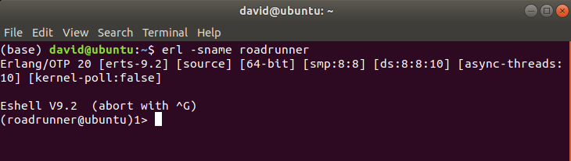
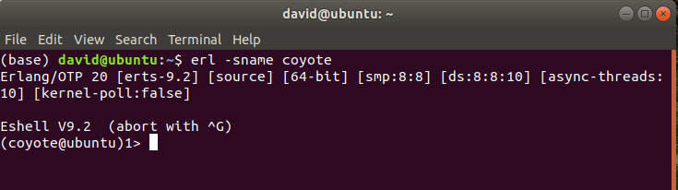
Distributed Erlang Programming
Erlang node
An executing Erlang runtime system that has been given a name.
Multiple nodes can run on a single host, but they can also be running on different host computers, too.
Open two nodes on one host
Erlang command that gives a short name to a node: erl –sname <name>
The sname will name a host on the local network, and takes the form

Slide 12
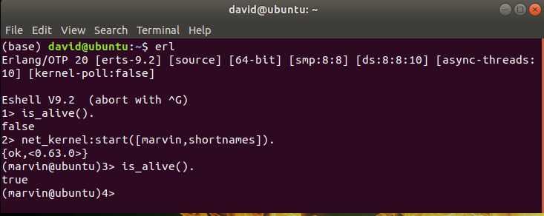

Erlang – Local node
is_alive() -> boolean()
Returns true if the local node is alive (that is, if the node can be part of a distributed system), otherwise false.
net_kernel:start([Name]) -> {ok,pid()} | {error,Reason}
Turns a non-distributed node into a distributed node by starting net_kernel and other necessary processes.
Each live node has to be named and names must be unique on the same host. Duplicates are allowed across different hosts.

Slide 13
Net Kernel Module (net_kernel)
get_net_ticktime() -> Res – An approximated time a connected node may be unresponsive until it is considered down and thereby disconnected.
Once every TickTime/4 seconds, each connected node is ticked if nothing has been sent to it during that last TickTime/4 interval.
A tick is a small package sent on the connection. A connected node is considered to be down if no ticks or payload packages have been received during the last four TickTime/4 intervals.
TickTime defaults to 60 seconds. Thus, 45<T<75 seconds is the interval where a "down node" is detected.
Notice that all communicating nodes are to have the same TickTime value specified, as it determines both the frequency of outgoing ticks and the expected frequency of incoming ticks.
Read more about net kernel functions:
monitor_nodes(Flag, Options) -> ok | Error
set_net_ticktime(NetTicktime, TransitionPeriod) -> Res
stop() -> ok | {error, not_allowed | not_found}
start([Name]) -> {ok,pid()} | {error,Reason}
http://erlang.org/doc/man/net_kernel.html

Slide 14

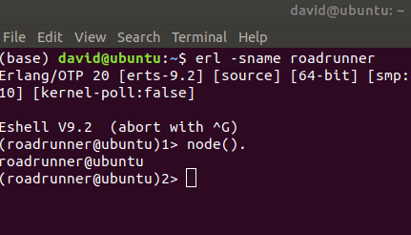
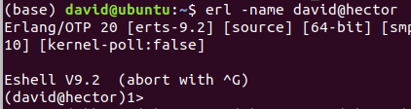
Node’s Name
The sname names a node on host of the local network. The form is name@host
The host name can be found by shell command: hostname
Get node’s name by calling: node().
The long name is defined by: erl –name <sname>@<host>
The name gives the full IP address of the host
This could be “roadrunner@192.168.0.5”
In Linux - Hosts are defined in a system file: /etc/hosts
You can add a new host name and a corresponded IP address.
The hosts file is organized as pairs: <IP address> <host name>
127.0.0.1 is a special address of self loop which means your computer send messages to itself.
If you want to communicate with other machines their IP address must be defined in hosts.

Slide 15
Node Names
Nodes with long names can communicate only with other nodes with long names
Similarly, nodes with short names can communicate only with other nodes with short names

Slide 16
Cookies
In order to establish communication between nodes, nodes must share the same cookie value.
A cookie value is an atom given on erlang initialization: erl –sname foo –setcookie dummycookie
If no value is set on launch, the Erlang runtime system will pick up the value stored in the file .erlang.cookie
If the file does not exist, it will be created in the home directory of the user's account and a randomly generated secret cookie value will be stored in it
Nodes created on the same user account will share the same cookie value by default.
Test Nodes Connection
Use net_adm:ping function.
ping(‘a@host’)->pang – communication failed
ping(‘a@host’)->pong – communication succeeds

Slide 17
Build A Simple Name Server
The name server is called kvs (its registration name).
It is a simple key/value server with the following interface:
@spec kvs:start() -> true - starts the server, registers the name kvs.
@spec kvs:store(Key,Value)->true – associate Key with Value
@spec kvs:lookup(Key)-> {ok,Value} | undefined – lookup for key and returns {ok,Value} if existed.
Home Assignment I (No submission is required here)
Do the following using the kvs.erl module.
Open two terminals and two nodes with shortnames: roadrunner and coyote
(coyote @<host>)> kvs:start().
(roadrunner @<host>)> rpc:call(coyote@<host>, kvs, store, [mip,{mip,mip}]).
(roadrunner@<host>)> rpc:call(coyote@<host>, kvs, lookup, [mip]).

Slide 18
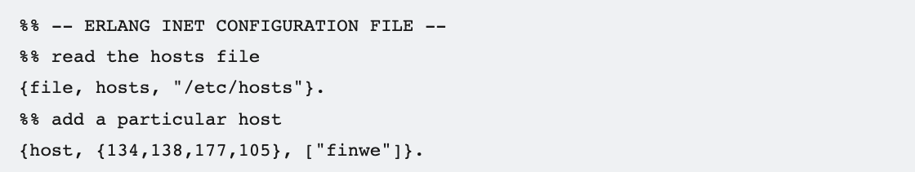
Inet configuration
In some systems we can’t edit the /etc/hosts file due to privildges constraints.
The solution is to use inet configuration where we specify a custom hostnames file. Full example on erlang documentation: Erlang -- Inet Configuration
Create a file, called “erl_inetrc” (as an example).
Change the hosts file location or add a host:
erl -kernel inetrc '"./cfg_files/erl_inetrc"'

Slide 19
Client and Server on Different Machines on the Same LAN
Home Assignment II In Pairs (No submission is required here)
Use two computers that are connected to the same LAN.
Write the IP address of your friend’s computer in /etc/hosts file e.g. 192.168.0.2 obama 192.168.0.3 trump
Each /etc/hosts file should contain the translations of name to an IP address
Find the IP using the Linux command: ip address
You can’t edit /etc/hosts file without having root privileges.
Open two erlang nodes one each PC. Use the same cookie value e.g. erl –name coyote@obama –setcookie usa erl –name roadrunner@trump –setcookie usa
Test the connection between nodes using net_adm:ping()
Make sure that port 4369 is open for both TCP and UDP traffic. This port is used by a program called epmd (short for the Erlang Port Mapper Daemon).
Copy kvs.erl to both machines and compile kvs.erl in both shells
Repeat on steps from H.W I in roadrunner’s shell.
Complete these two home assignments before the last day of the semester.
Questions that relate to communication between nodes won’t be answered during the tests season.

Slide 20
#4 RPC
Remote Procedure Call
Implemented in module rpc
This module contains
Remote procedure calls A method to call a function on a remote node and collect the answer
Broadcast facilities and parallel evaluators
Main uses
Collecting information on a remote node Remote procedure has access to local data in the remote node
Running a function with some specific side effects on the remote node For example, run a process or shut down a running one
Upon calling rpc:call/1, system is in blocking point.

Slide 21

#4.1 RPC: Example
Caller Callee
Start
doing
something
Start
doing
something

Slide 22
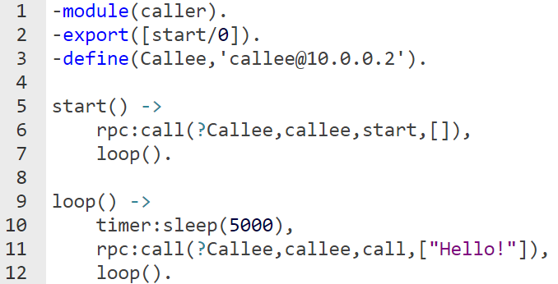
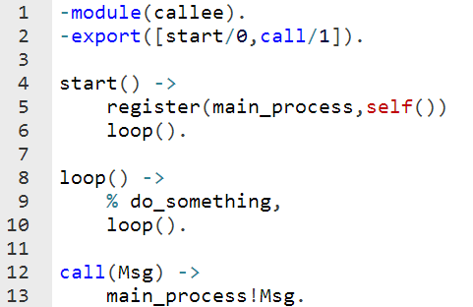
#4.1 RPC: Example
Caller
caller@10.0.0.1
Callee
callee@10.0.0.2
RPC
Program flow
Messaging

Slide 23
#5 Submission Procedures
Only a single .erl file to be submitted
Filename format: ex8_<ID>.erl
Where <ID> needs to be replaced with your ID number
Your code MUST be well documented
Functions’ names must be identical to the ones defined in exercise
Same as for the arity
Same as for the output format
Only the tested functions needs to be exported
Internal functions MUST NOT be exported
Assignments will be tested automatically in using Erlang shell in Linux
No excuses
You must compile the modules you may call to in the remote host in advance
Don’t forget setcookie and –sname configurations
erl –setcookie secretkey –sname caller
secretkey – secret atom to connect remotely. Must be identical in both hosts
name – identifier of specific Erlang machine in a host
ipAddress – host’s local IP address (self loop 127.0.0.1) if you use longnames

Slide 24
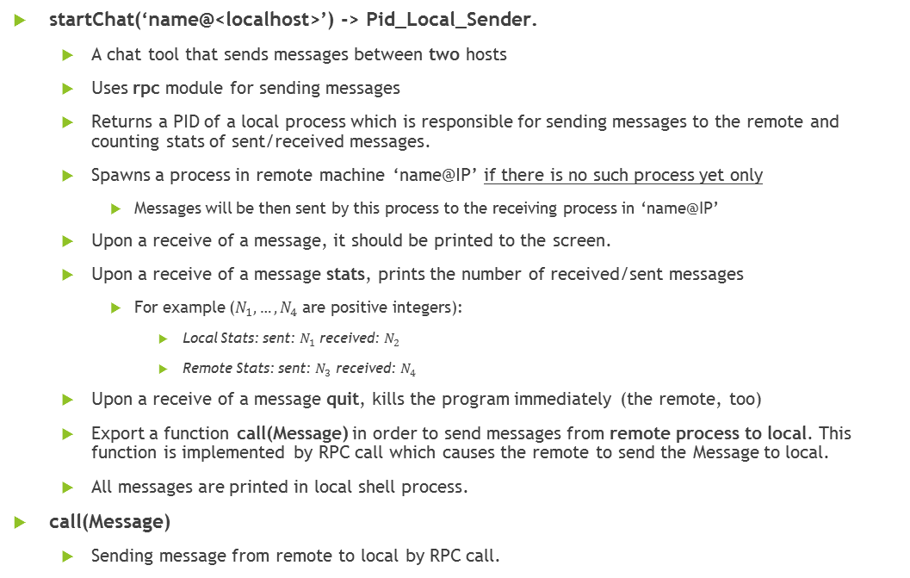
Exercise 8
startChat(‘name@<localhost>’) -> Pid_Local_Sender.
A chat tool that sends messages between two hosts
Uses rpc module for sending messages
Returns a PID of a local process which is responsible for sending messages to the remote and counting stats of sent/received messages.
Spawns a process in remote machine ‘name@IP’ if there is no such process yet only
Messages will be then sent by this process to the receiving process in ‘name@IP’
Upon a receive of a message, it should be printed to the screen.
Upon a receive of a message stats, prints the number of received/sent messages
For example ($N_{1},…,N_{4}$ are positive integers):
Local Stats: sent: $N_{1}$ received: $N_{2}$
Remote Stats: sent: $N_{3}$ received: $N_{4}$
Upon a receive of a message quit, kills the program immediately (the remote, too)
Export a function call(Message) in order to send messages from remote process to local. This function is implemented by RPC call which causes the remote to send the Message to local.
All messages are printed in local shell process.
call(Message)
Sending message from remote to local by RPC call.

Slide 25
Exercise 8
Example of the interface of the chat:
Creating chat: Pid_Local_Sender = startChat(‘RemoteName@<localhost>’)
Sending message from local to remote: Pid_Local_Sender ! Message
Sending message from remote to local by RPC call: ex8_<ID>:call(Message)
Example of local shell flow: 1> ex8:call(something). something 2> ex8:call(stats). Local Stats: sent: 0 received: 2 3> Pid_Local_Sender ! hey 4> Pid_Local_Sender ! stats Remote Stats: sent: 2 received: 2 5> ex8:call(stats). Local Stats: sent: 2 received: 3
6> ex8:call(quit).
<PID_Remote> - Successfully closed.
<PID_Local_Sender> - Successfully closed.
Pay Attention to spaces and spelling mistakes
Code is examined by automation!

Slide 26
Exercise 8
steadyLink(F)->Spawned_PID
Spawns a process to evaluate function F/0
Links the two processes
Terminates after 5 seconds if no exception occurs
Returns the PID of spawned process
steadyMon(F)->Spawned_PID
Spawns a process to evaluate function F/0
Monitors the spawned process
Returns the PID of spawned process
Catches any type of termination of F/0 and prints the corresponding result (string)
“Normal termination of process 0.24.0 was detected”
“An exception in process 0.24.0 was detected: <info>”
<info> is the last attribute of ‘DOWN’ message: {'DOWN', MonitorRef, Type, Object, Info}
Terminates after 5 seconds and kills the spawned process.

